Slide 1
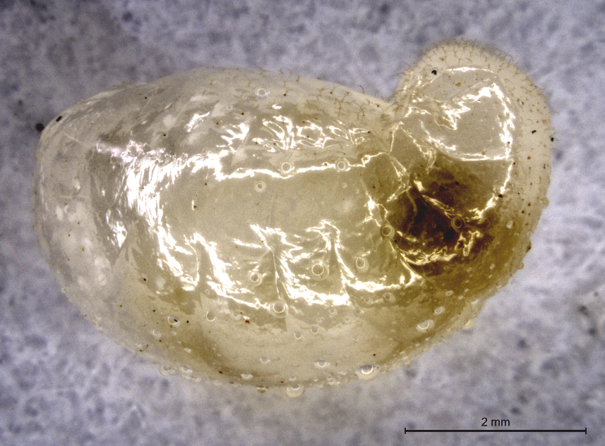
Red imported fire ant, Solenopsis invicta
Fourth
Instar
Reproductive
Larva:
Whole body,
Lateral Habitus.
The larva is
approximately
6 mm in length.
Mouth
NSF-IOS 1257837: Neuropeptide receptors and identification of genes in signaling networks
involved in reproduction and nutrition in the red imported fire ant.
PI: P.V. Pietrantonio, Co-PI: C. Tamborindeguy.
Texas AgriLife Research

Slide 2
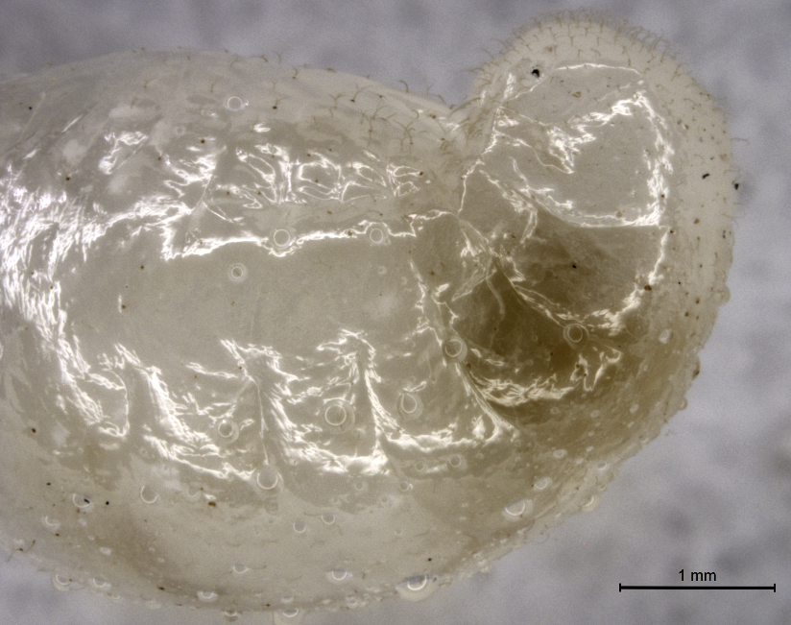
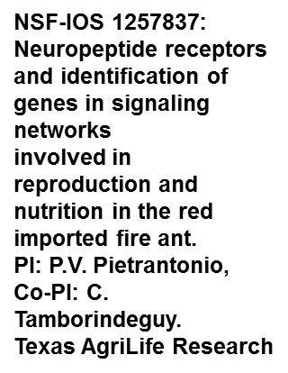
Red imported fire ant, Solenopsis invicta
Fourth
Instar
Reproductive
Larva:
Lateral Habitus
Head

Slide 3
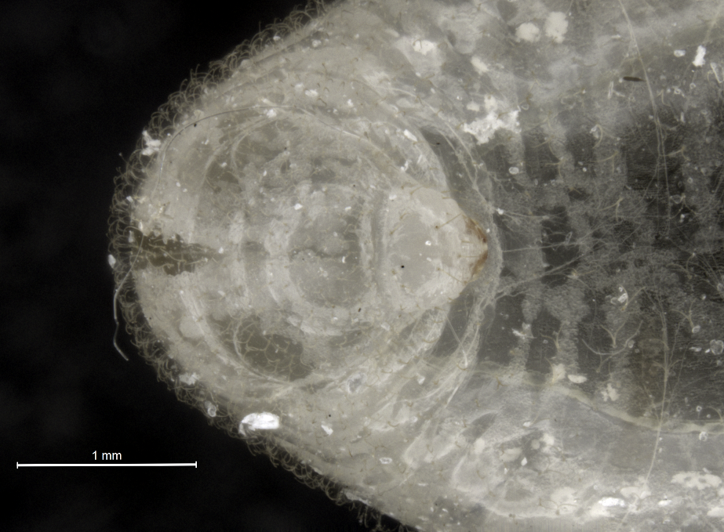
Fourth instar reproductive
larva: Detail of head and
anterior body.
The larva was placed
on its dorsal side and the view
is from the top.
The mouthparts are brown,
where the cuticle is sclerotized.
The dorsal aorta (heart)
can be seen through
the transparent cuticle.
Notice hairs on the surface of
the body, more clearly seen
against the black background.
Trachea can be also seen
through the cuticle (white or
silver filaments).
White speckles on the surface
are dirt particles.
NSF-IOS 1257837
PI: P.V. Pietrantonio,
Co-PI: C. Tamborindeguy
HEAD
AORTA
MOUTHPARTS
TRACHEA

